Slide 1

NFC
About us
Name:- Mr.Krish Ujeniya
En No:- 216120316028
Guided by:- Mr.Dharmesh Dhanger

Slide 2
CONTENT
01
03
Introduction of NFC
Working Of NFC
02
04
NFC tags
Applications Of NFC

Slide 3

01
Introduction of NFC

Slide 4
Near field communication
NFC allows you to share small payloads of data between an NFC tag and an Android-powered device, or between two Android-powered devices.
NFC is an Extention of Radio frequeancy identification Technology.

Slide 5
Near field communication
RFID is used for tracking and identification by sending radio waves.
NFC is mainly aimed for handheld devices.

Slide 6
History of NFC
➢ In 1983 First RFID patent
➢ In 2004 NFC Forum created by Nokia,Philips and Sony
➢ In 2006 Nokia launches first NFC phone
➢ In 2010 samsung launches first Android NFC phone
➢ In 2011 Google Wallet launched
➢ In 2013 samsung and visa plans the Mobile payment with NFC

Slide 7
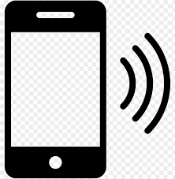
Type of NFC Devices
a) Active devices :-
It have a power source and can send and receive data by switching between the normal active (transmitting) state and a passive (receiving) state.
Example : Mobile

Slide 8
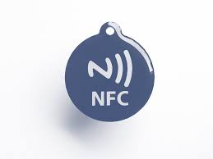
Type of NFC Devices
b) Passive devices :-
It have no power source and can only connect to active devices.
Example : NFC tags

Slide 9
02
NFC Tags

Slide 10
NFC Tags
A NFC tag is a sticker with small microchips that can be read by in range mobile devices. Information is stored in these microchips.
NFC tags also perform a variety of actions, such as changing handset settings or launching a website.

Slide 11
NFC Tags
You can write data to an NFC tag using an NFC-enabled Mobile phone.
Most used App :
NFC Tools
NXP TagWriter
Trigger
Simply NFC

Slide 12
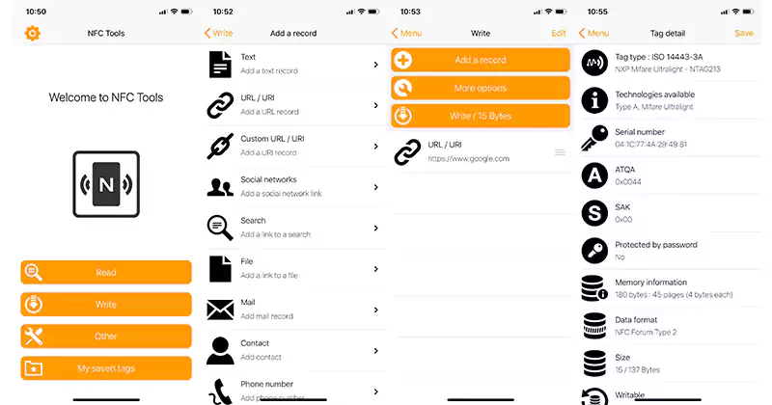
NFC Tools App

Slide 13
Program NFC Tags using python
import nfc
import ndef
from threading import Thread
def beam(llc):
snep_client = nfc.snep.SnepClient(llc)
snep_client.put_records([ndef.UriRecord('http://nfcpy.org')])
def connected(llc):
Thread(target=beam, args=(llc,)).start()
return True
with nfc.ContactlessFrontend('usb') as clf:
clf.connect(llcp={'on-connect': connected})

Slide 14
03
Working of NFC

Slide 15
Working of NFC
NFC based on inducive coupling.
NFC works using magnatic induction between two loop antenas located within each other’s near field.

Slide 16
Working of NFC
Operating frequency 13.56 MHz.
Data rate 106 kbit/s to 424 kbit/s.
NFC use initiator and a target when the initiator actively generates RF field that can power a passive target.

Slide 17
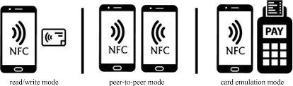
Type of Working
a) Peer-to-peer mode :–
Active NFC devices exchange information by switching between passive and active states.

Slide 18
Type of Working
b) Read/write mode :–
Active NFC device reads or writes information from/on a passive NFC device.

Slide 19
Type of Working
c) Card emulation :–
An Active NFC device used for contactless payment.

Slide 20
04
Applications Of NFC

Slide 21
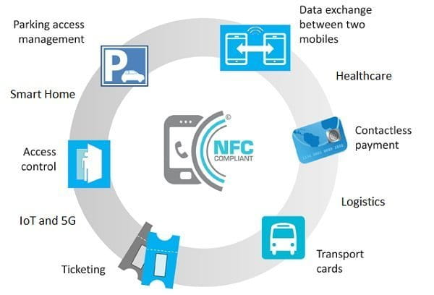
Applications Of NFC
1. Data transfer
2. Mobile payments
3. Quick pairing
4. Public transport access
5. Gaming

Slide 22
Advantages
It is advantageous to perform installments and other transactions utilizing cell phones with the assistance of wallet applications.
It is utilized for numerous applications in different areas, for example, banking, reservations, booking tickets, recovering, passage/leave passes, and so on.
It helps the two clients and ventures.

Slide 23
Advantages
It gives tied down admittance to understudies and workers in their premises.
It gives greater security contrast with attractive strip based charge and Mastercards. It additionally utilizes PIN.
It doesn’t need search and pair methodology like Bluetooth and different techniques to build up availability.

Slide 24
Disadvantages
It is extravagant for the organizations to embrace the NFC empowered gadgets.
It isn’t so worthwhile for clients because of complex methods contrast with other simple choices.
The power utilization is relatively more in NFC empowered gadgets.

Slide 25
References
1. https://en.wikipedia.org/wiki/Near-field_communication
2. https://developer.android.com/guide/topics/connectivity/nfc
3. https://nfc-forum.org/
4. https://www.freeiconspng.com/images/nfc-icon
5. https://toppng.com/show_download/467043/nfc-logo-vector-n-mark-free-download/large
6. https://uc.yamaha.com/insights/blog/2018/december/what-is-nfc/
7. https://zapped.to/blog/program-an-nfc-tag/
8. https://www.google.com/search?channel=fs&client=ubuntu&q=history+of+nfc
9. https://www.geeksforgeeks.org/advantages-and-disadvantages-of-near-field-communication/

Slide 26
THANK YOU

